Slide 1

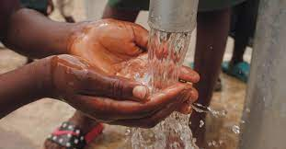
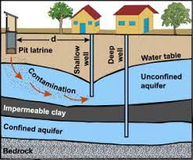
Water Works: Unearthing Insights from Tanzania's Aquifer Data

Slide 2


CONTENT
01
OVERVIEW
02
BUSINESS UNDERSTANDING
04
DESCRIPTIVE ANAYSIS
05
MODELLING
06
EVALUATION
07
RECOMMENDATIONS
08
NEXT STEPS

Slide 3



OVERVIEW
This project focuses on predicting the condition of water wells in Tanzania, aiming to aid stakeholders in effectively managing water infrastructure and ensuring access to clean water. By leveraging machine learning techniques, the project aims to provide insights into the factors influencing well conditions and offer actionable recommendations for maintenance and improvement strategies.
CUSTOMERS

Slide 4

BUSINESS UNDERSTANDING
The stakeholders involved in this project include NGOs focused on water infrastructure management, governmental agencies responsible for water resource allocation, and communities relying on well water for daily needs. The dataset chosen contains valuable information about water points in Tanzania, including pump type, installation year, geographic location, and water quality indicators. This dataset was selected due to its relevance to the real-world challenges faced in providing clean water to the population.

Slide 5



PURPOSE
Forecasting Water Pump Conditions?
Anticipating Water Pump Failures?
Predicting Water Pump Status?

Slide 6

DESCRIPTIVE ANALYSIS
In this section, we delve into key insights derived from our descriptive analysis of water well data. Through comprehensive visualizations and statistical summaries, we uncover crucial factors influencing water well conditions. Our exploration aims to provide valuable insights to guide strategic decisions for maintaining and improving water infrastructure in Tanzania.

Slide 7
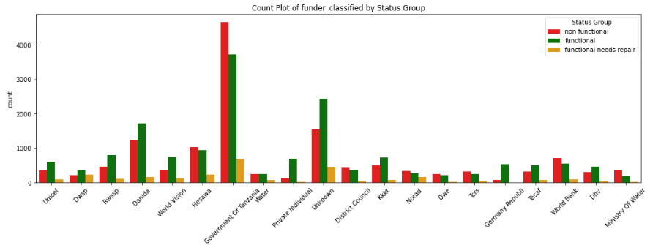
Funding
Government-funded wells often exhibit a higher likelihood of being non-functional, highlighting a need for improved oversight or maintenance practices in these projects

Slide 8
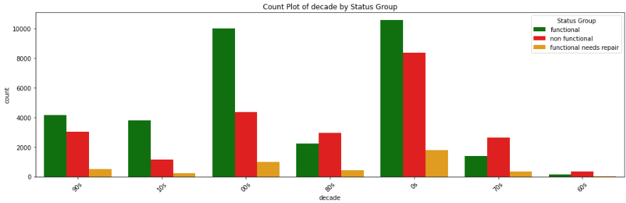
Year of Installation
Recent years have seen a higher proportion of functional wells compared to older ones, but there are still functional wells that require repair. This underscores the importance of timely maintenance to prevent functional wells from deteriorating into non-functional ones.

Slide 9
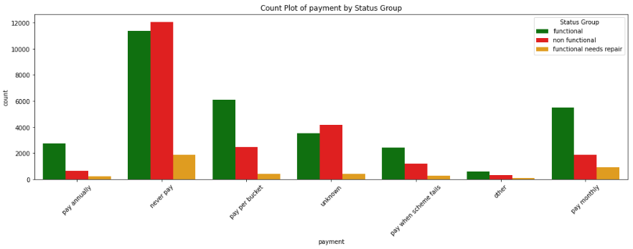
PAYMENT
The water wells that are paid for are majorly functional compared with water wells that are not paid for

Slide 10

MODELING
Model Selection
Hyperparameter Tuning
Data Preprocessing
Handling missing values
Encoding categorical variables (Target Encoder)
Scaling numerical features (Robust Scaler)
A Random Forest Classifier was chosen as the predictive model due to its ability to handle complex relationships in the data and provide insights into feature importance
Parameters tuned: n_estimators, max_depth, min_samples_split, min_samples_leaf, max_features, bootstrap
Best parameters identified through grid search and cross-validation.

Slide 11
EVALUATION
Model Selection
Confusion Matrix
Model Performance Metrics
Accuracy: Train Accuracy (0.9025), Test Accuracy (0.7870)
Balanced Accuracy: Train Balanced Accuracy (0.9310), Test Balanced Accuracy (0.7161)
A Random Forest Classifier was chosen as the predictive model due to its ability to handle complex relationships in the data and provide insights into feature importance
Visualization of true vs predicted labels
Interpretation of model performance across different classes

Slide 12
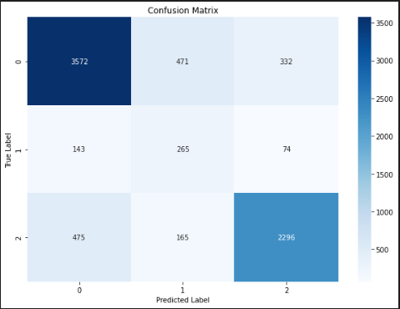
CONFUSION MATRIX DISPAY
Test set balanced accuracy score of 0.7161.
Room for improvement in handling class imbalance and overall prediction accuracy.

Slide 13
RECOMMENDATIONS
Targeted Maintenance Approach: Utilize insights from EDA and modeling to implement a targeted maintenance approach.
Optimize Resource Allocation: Leverage EDA findings and feature importance from the modeling phase to optimize resource allocation.
Continuous Monitoring and Feedback Loop: Establish a continuous monitoring system informed by EDA insights and model predictions

Slide 14
NEXT STEPS
Optimize Resource Allocation: Leverage EDA findings and feature importance from the modeling phase to optimize resource allocation
Validation and Deployment of Model: Validate the predictive model using additional datasets or real-time data to ensure its accuracy and reliability. Once validated, deploy the model for ongoing monitoring and prediction of water well conditions.
Actionable Insights Implementation: Implement actionable insights derived from the EDA analysis, such as prioritizing maintenance in high-population areas, improving water quality monitoring, and investing in pumping infrastructure.

Slide 15
CONCLUSION
In conclusion, this project demonstrates the potential of machine learning in addressing water infrastructure challenges in Tanzania. By predicting water well conditions and providing actionable insights, stakeholders can make informed decisions to improve clean water access and ensure sustainable water management practices. Further enhancements and collaborations with domain experts can lead to even greater impact and positive outcomes for communities relying on well water sources.

Slide 16

THANK YOU

